Slide 1

Attention Based Natural Language Grounding By Navigating Virtual Environment
Abhishek Sinha*, Akilesh B*, Mausoom Sarkar, Balaji Krishnamurthy
Notes:
Hi
I am XXXXXX from Adobe and I am going to talk about our teams work on language grounding by navigating virtual environment.

Slide 2
Do Images we see give meaning to our words?
Notes:
Do Images we see give meaning to our words?

Slide 3
Notes:
How about these words?

Slide 4
“The bat didn’t fit into the bag because it was too big”
or
“The bat didn’t fit into the bag because it was too small”
What does “it” refer to?
Notes:
or sample this
“The bat didn’t fit into the bag because it was too big”
or
“The bat didn’t fit into the bag because it was too small”
In both these sentences it refers 2 different things

Slide 5
The meaning is embedded in context
Notes:
So meaning is embedded in context

Slide 6
i.e.
grounded in experience
Notes:
and grounded in experience

Slide 7
Language is grounded in experience
Notes:
And therefore language is grounded in experience

Slide 8
Teaching agents the essence of words
Notes:
For Teaching agents the essence of words we need to ground them in experience.

Slide 9
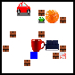
Virtual Environments
Notes:
We can use virtual environments to perform various tasks to give them this experience

Slide 10
Performing a navigation task aided by language.
Go to south of large red Cup
Notes:
and in our case we use a navigation task aided by language to do this.

Slide 11
Virtual Environments
2D environment
63 different objects
Each object can have multiple color or size
Notes:
We created a 2d environment for this purpose with various objects of multiple colour and sizes.

Slide 12
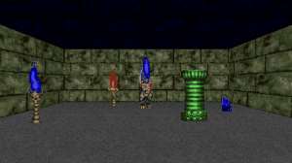
VizDoom based 3D environment
70 different instructions
Chaplot et al. Gated-attention architectures for task-oriented language grounding. (2017)
Notes:
We also test or model on the vizdoom 3d environment which has been earlier used in the gated attention paper by chaplot.

Slide 13
Methodology
Agent takes image, instruction as input
Agent outputs an action on the basis of combined representation.
Trained in an end-to-end way via reinforcement learning (A3C)
Notes:
Our agent takes in images and textual instructions as inputs. Based on these it performs various actions and it is trained in an end to end manner using reinforcement learning.

Slide 14
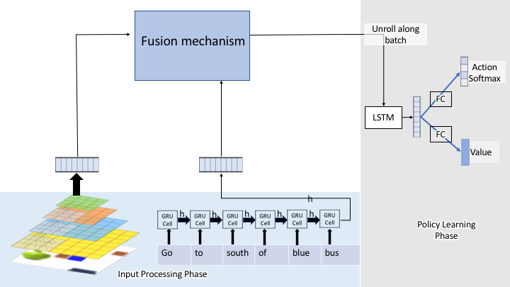
Model
Notes:
This is how a typical language grounding model performing a navigation tasks looks like.
It featurizes the image input using cnn,

Slide 15
Model
Notes:
language input using a Rnn and

Slide 16
Model
Notes:
has a fusion mechanism which fuses the language and visual features together and

Slide 17
Model
Notes:
it passes it on to the policy learning phase.

Slide 18
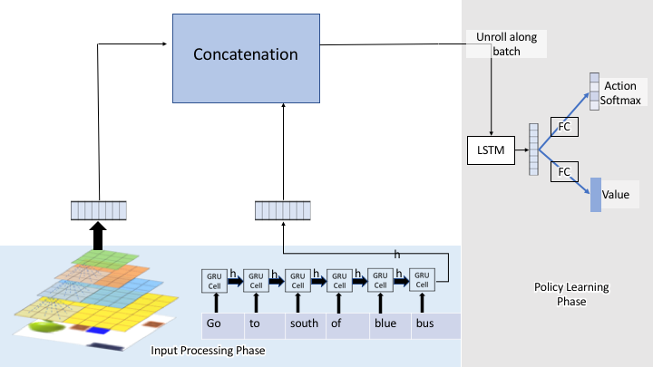
Prior art
Hill et al. Understanding grounded language learning agents. (2018)
Notes:
Earlier works used concatenation and

Slide 19
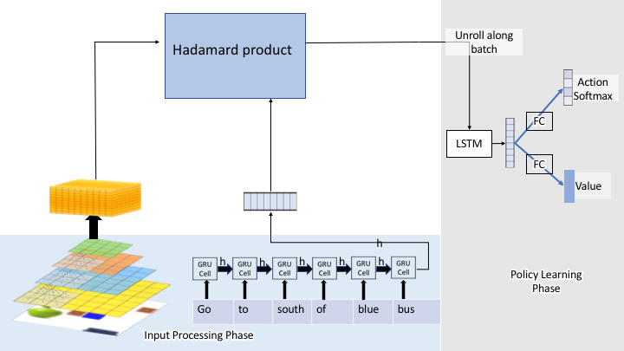
Prior art
Chaplot et al. Gated-attention architectures for task-oriented language grounding. (2017)
Notes:
hadamard product to do fusion of the visual and textual representations.

Slide 20
Our Fusion approach
Produce multiple text feature vectors
Notes:
We propose a different mechanism to do this fusion.
We project the language representation into multiple feature vectors and

Slide 21
Our Fusion approach
Convolve each feature vector with the image volume
Notes:
convolve them with visual feature volume to produce multiple attention maps.

Slide 22
Our Fusion approach
Concatenate all the attention maps
Notes:
Which is then concatenated and passed on to the policy learning phase

Slide 23
Our Fusion approach
Notes:
where we use a3c

Slide 24
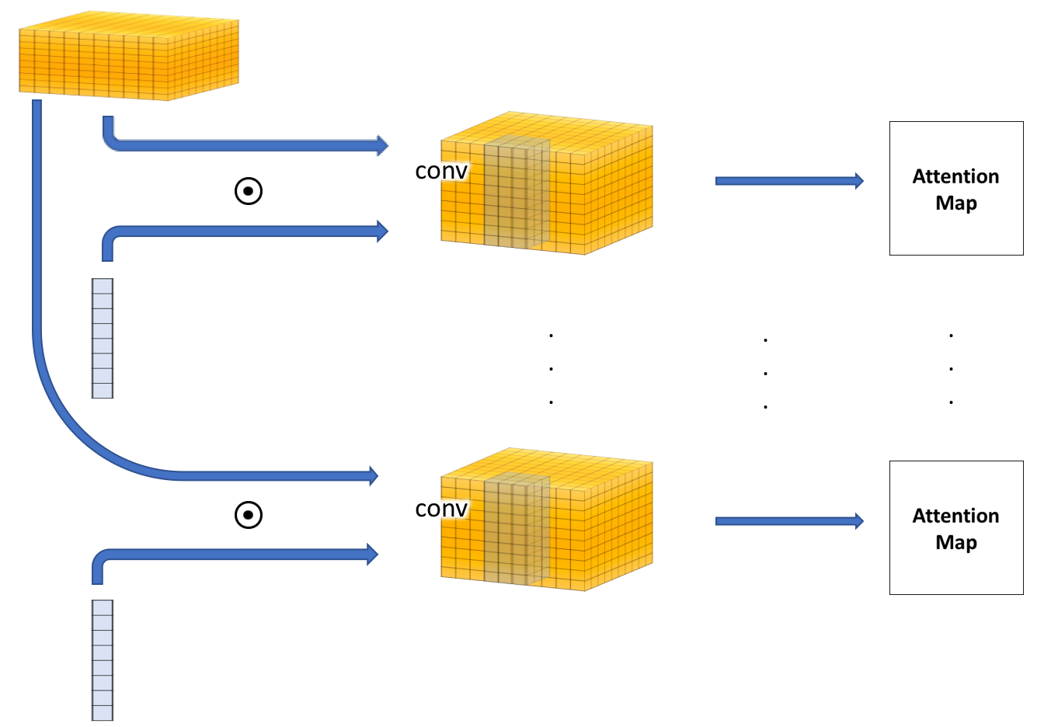
Fusion mechanism
feature volume
text feature vectors
Notes:
We do this convolution of visual feature volume with different text features to help the model in relating the language input with the things present in the image. It helps the Model to look out for multiple features in the image based on the instruction.

Slide 25
Evaluation mechanism
Unseen scenario generalization (US)
Unseen environment scenarios with instructions in train set.
Zero-shot generalization (ZS)
Unseen instructions.
Notes:
We evaluate our model on 2 different behaviours
Unseen scenario generalization: in which we put our learned model into a environment comprising of object attributes and arrangements that it has not seen earlier
and
Zero-shot generalization: where in addition to unseen scenario our agent also gets instruction that it has not got earlier

Slide 26
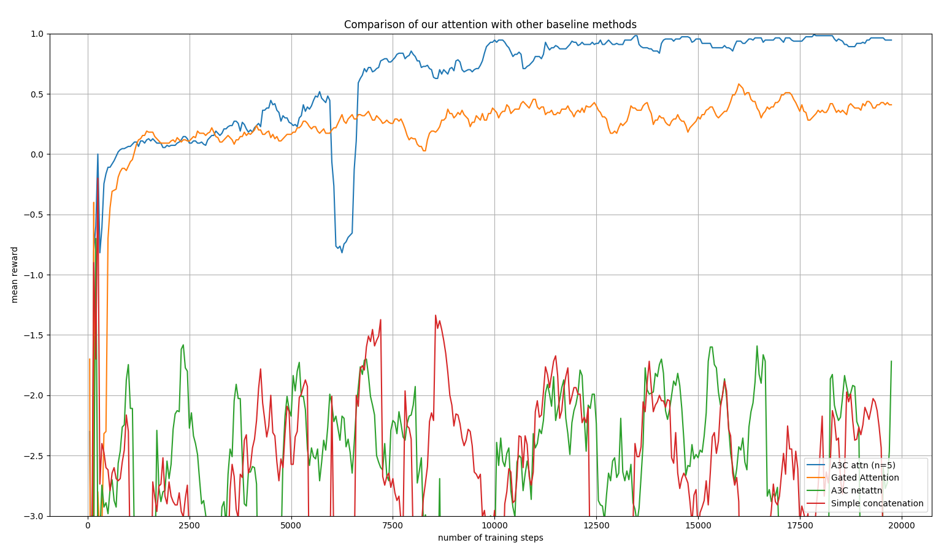
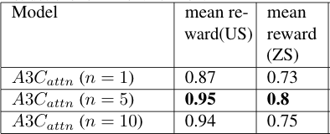
2D Results
Notes:
Here we show how our model performs in a 2d environment. Its clear that we outperform the baseline methods and also our model which has 5 attention maps performed the best.

Slide 27
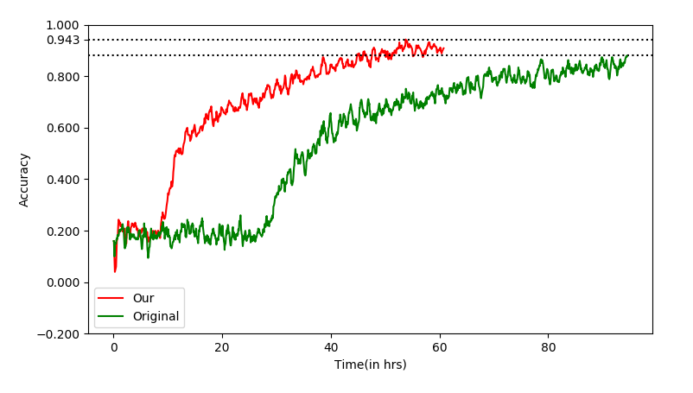
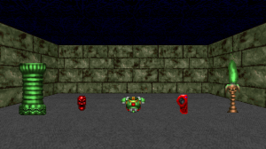
3D results
Easy difficulty
Chaplot et al. Gated-attention architectures for task-oriented language grounding. (2017)
Notes:
In 3d environment our model outperforms the state-of-the-art both in term of accuracy and training time in all the 3 scenarios.

Slide 28
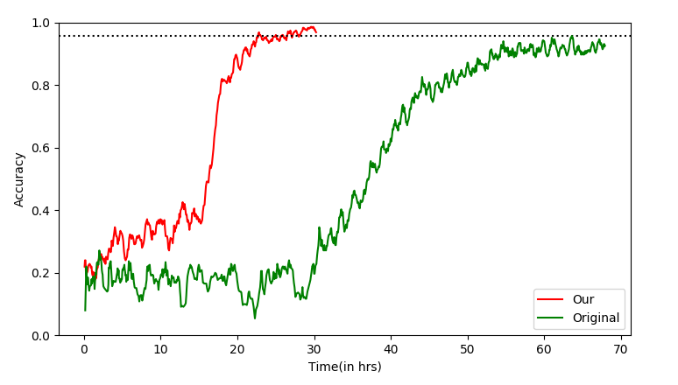
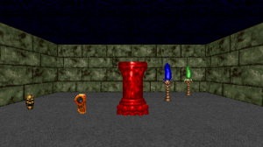
3D results
Medium difficulty
Chaplot et al. Gated-attention architectures for task-oriented language grounding. (2017)

Slide 29
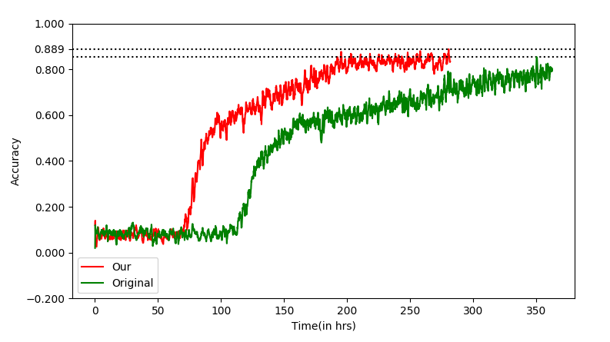
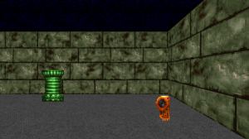
3D results
Hard difficulty
Chaplot et al. Gated-attention architectures for task-oriented language grounding. (2017)

Slide 30




Attention maps
View of agent
Map 1
Map 2
Map 3
Attention maps for the instruction – “Go to small red car”
Notes:
We overlayed the generated attention maps on to the input image and it can bee seen that the model is focusing on multiple areas in the image both in 2d and

Slide 31
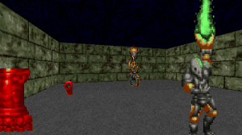

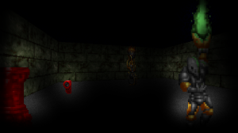
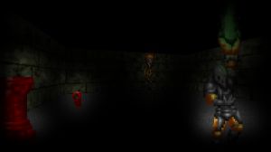
Attention maps
View of agent
Map 1
Map 2
Map 3
Attention maps for the instruction – “Go to tall green torch”
Notes:
3d case.

Slide 32
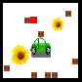
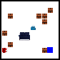
Language Grounding in 2D
There are multiple yellow Flower. Go to larger one
There is a small blue bag. Go to it
Notes:
Here are a few examples of our model perfoming in a 2d environment .......... and

Slide 33
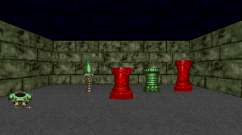
Language Grounding in 3D
Go to the tall blue object
Go to the short green pillar
Notes:
3d

Slide 34
Vector arithmetic on instructions
Notes:
So how well did the model learn the meanings of the words. We projected the language vector onto 2d space using pca and subtracted feature vector of different sentences to visualise the direction of words such as small.....,medium.......,
north.......,east........ and they look parallel and it looks like it has understood these words

Slide 35
Language translation without parallel corpus
Training phase
Notes:
To test the generalizability of the model we also decided to perform a language translation task without any parallel corpus.
To do this we attached 2 rnn decoders to our existing model. However we turned on only 1 decoder at a time, during training. When we gave english instruction we switched on the english decoder and vice vesa for french.
But

Slide 36
Language translation without parallel corpus
85% translation accuracy
Evaluation phase
Notes:
during inference we swaped the decoders so while giving english instruction we turned on the french decoder and while giving french instruction we turned on the english decoder and we observed an 85% accuracy in translation on our small dataset.
This demonstrates the effectiveness of language grounding in learning the true meaning of words

Slide 37
THANK YOU!
Notes:
Thanks

